Slide 1


DATA ANALYSIS PROJECT
INSTRUCTOR:
AR KAR MIN
SUBMITTED BY:
RIMA NIGAM

Slide 2
PROJECT ON CUSTOMER CHURN MANAGEMENT
Who are the target customers?
What is the average churn rate?
What are the ways to retain the customers?

Slide 3
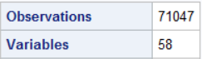
INTRODUCTION
In this project, I will analyze the customer churn dataset which contains various information of the existing customers like their Monthly Revenue, Monthly minutes, blocked calls, Service Area, Handset models and many more.
Churn is a huge factor in the Telecom Industry. Major initiators of churn include- Quality of service, tariffs, poor after sales service, low network connectivity etc.
On an average the annual churn rate experiences by the telecommunication industry is 15-25%. It costs almost 10-15 times more to acquire a new customer than to retain an existing customer. Therefore, the industry focuses more on customer retention than customer acquisition.
To reduce the customer churn, telecom companies need to predict which customers are at high risk of churn.
The study will be analyzed with the SAS programming language and is intended to illustrate the various features and procedures of this language.

Slide 4
Study Framework : Y and X variables
INDEPENDENT VARIABLES
MEDIATING VARIABLE
DEPENDENT VARIABLE
MONTHLY REVENUE
MONTHLY MINUTES
RETENTION CALLS
CHURN
RETENTION OFFERS
CREDIT RATING
MARITAL STATUS
CHILDRENINHH
TOTAL RECURRING CHARGE
HANDSET WEB CAPABLE/REFURBISHED

Slide 5
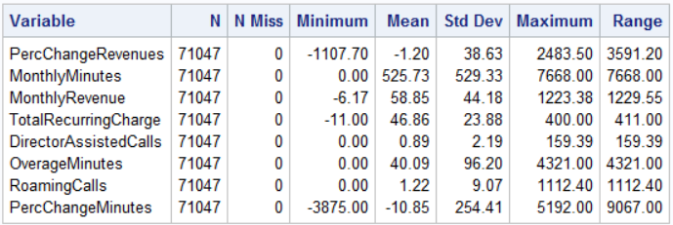
DATA VALIDATION
MISSING VALUES DETECTION
VARIABLE NAME | MISSING VALUE FREQUENCY
PercChangeMinutes | 502
PercChangeRevenues | 502
MonthlyMinutes | 216
MonthlyRevenue | 216
OverageMinutes | 216
RoamingCalls | 216
TotalRecurringCharge | 216
DirectorAssistedCalls | 216
ServiceArea | 28
Handsets | 1
HandsetModels | 1
CurrentEquipmentDays | 1
Handling missing values is an important part of the EDA process. The variables which are having very few missing values as compared to the size of the dataset, we may choose to drop the rows that have missing values. Otherwise, we planned to impute missing values based on the non-missing values in a column with the mean value. So, by using Stdize procedure we have replaced the missing values with the mean.

Slide 6
OUTLIER DETECTION AND TREATMENT
An outlier is that pattern which is dissimilar with respect to all the remaining patterns in the dataset. The discovery of outliers or extreme values is useful in detection of unpredicted and unidentified data in various areas.
Steps to Treat the outliers:-
Find the Q1, Q2 and IQR using PROC MEANS.
If a value is higher than 3 times of IQR above the Q3,It is considered as extreme outlier. Similarly, if it is lower than that then also it will be considered as extreme outlier.
A single macro program can detect and treat the outliers at the same time and remove the observations that are out of range.
MACRO | OUTLIER(DATA=, VARNAME=)
PARAMETER | DESCRIPTION
DATA | Specify an input dataset name
VARNAME | Continuous variable with outliers

Slide 7
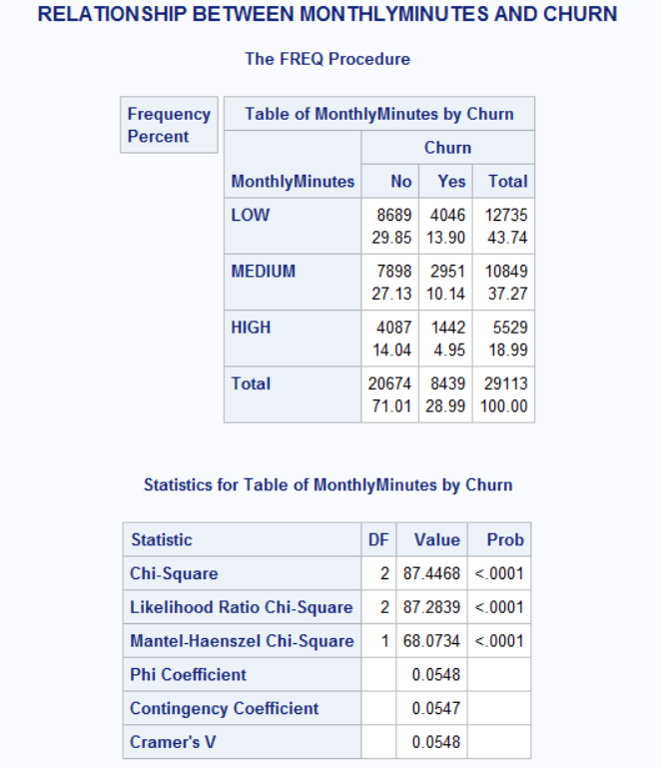
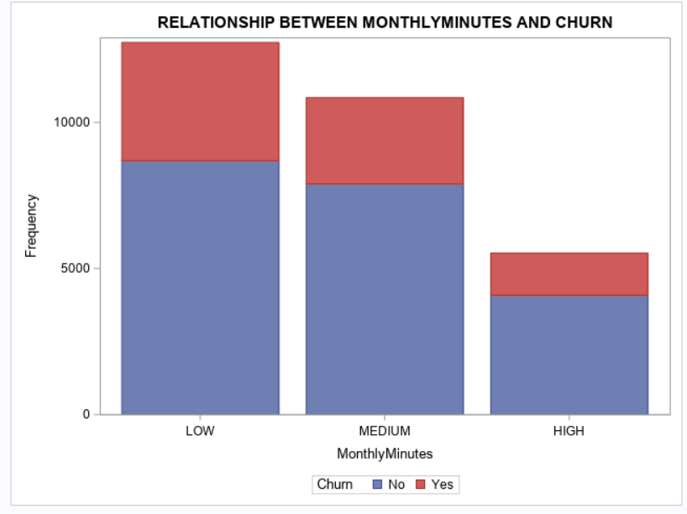
DATA TRANSFORMATION: CONTINUOUS TO CATEGORICAL VARIABLES
In the simplest situation, a recoding of a variable converts each raw value to an easier-to-interpret value.
In this dataset I have transformed the continuous variable to the categorical variable using Proc Format procedure under the macro program.

Slide 8
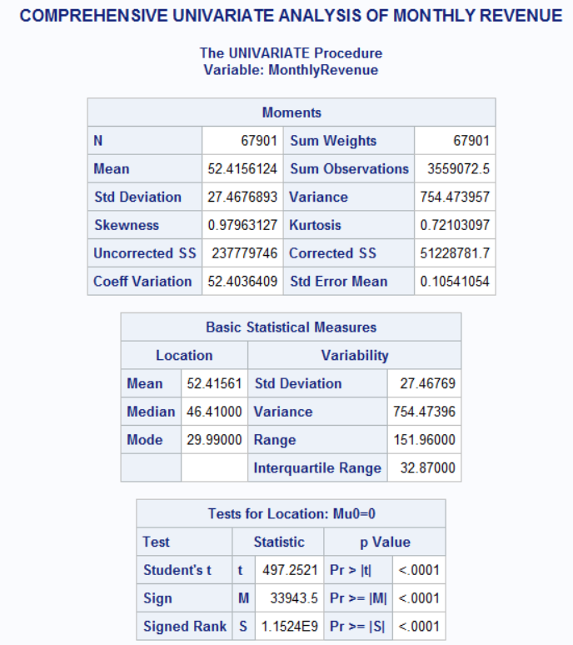
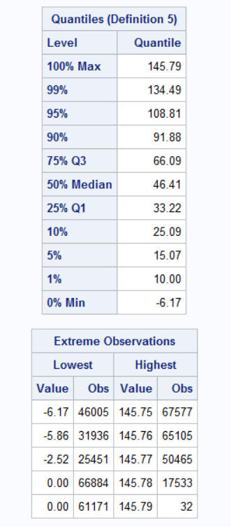
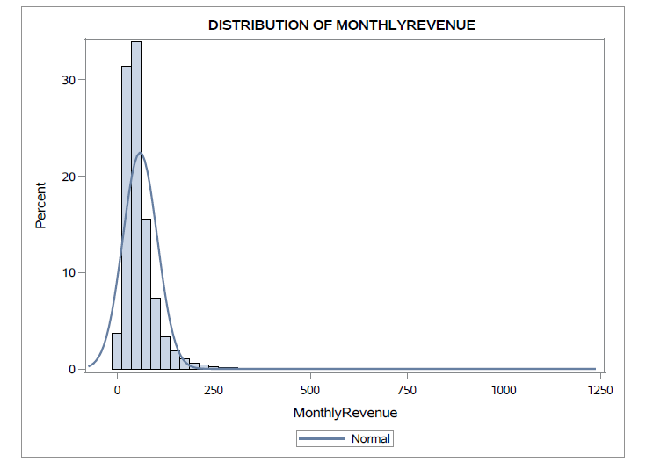
1) Comprehensive Analysis of Monthly Revenue

Slide 9
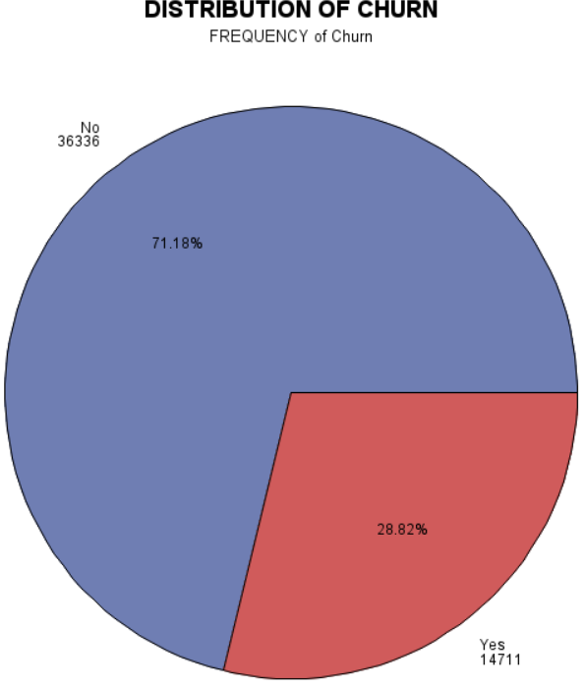
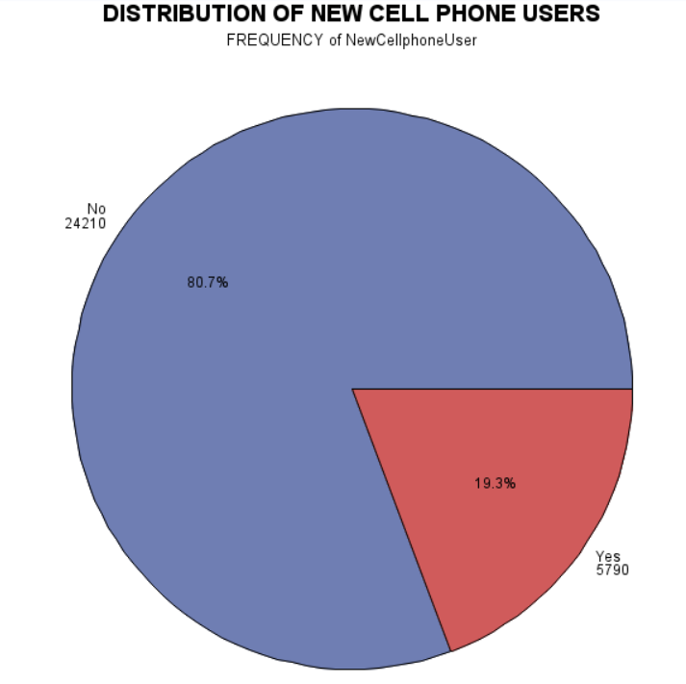
2) What is the churn rate and how many customers are new cell phone users’? Conclusion: As per this pie chart, around 80% customers prefer to go for ‘Bring your own phone plan’.

Slide 10
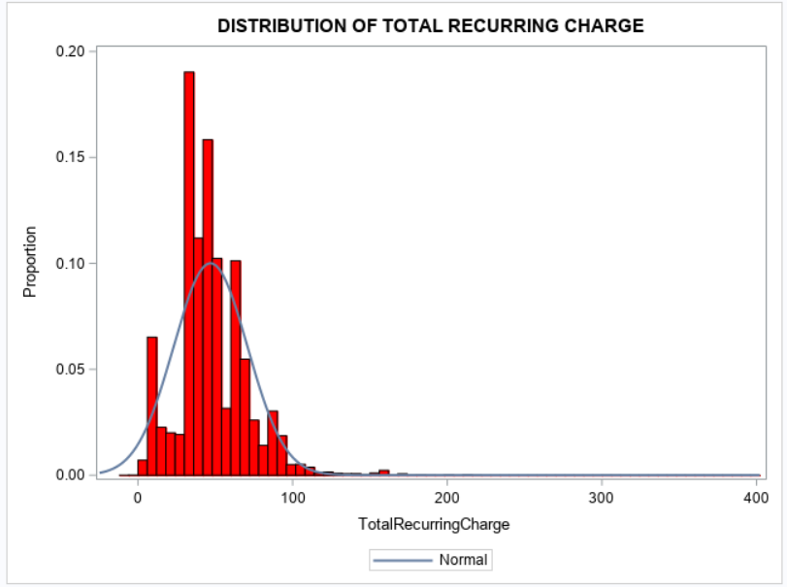
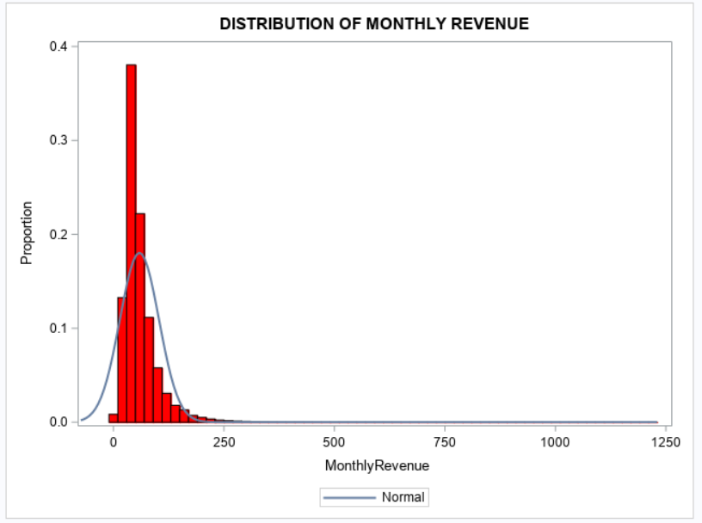
3) Does the recurring costs affects the monthly revenue? Conclusion: Recurring revenue helps the business owners to develop and stick to a reasonable budget. Knowing to earn a certain amount each month as Monthly revenue makes it easy to cover both routine and unexpected costs of the companies. With the recurring business model, they can predict revenues more accurately and business will get a higher value per user.
Distribution of Recurring Charge
Distribution of Monthly Revenue

Slide 11
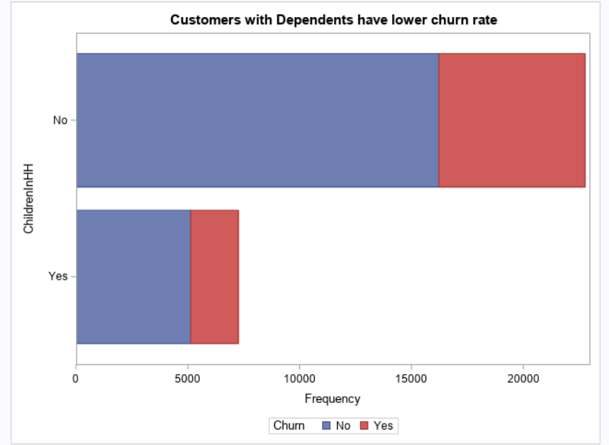
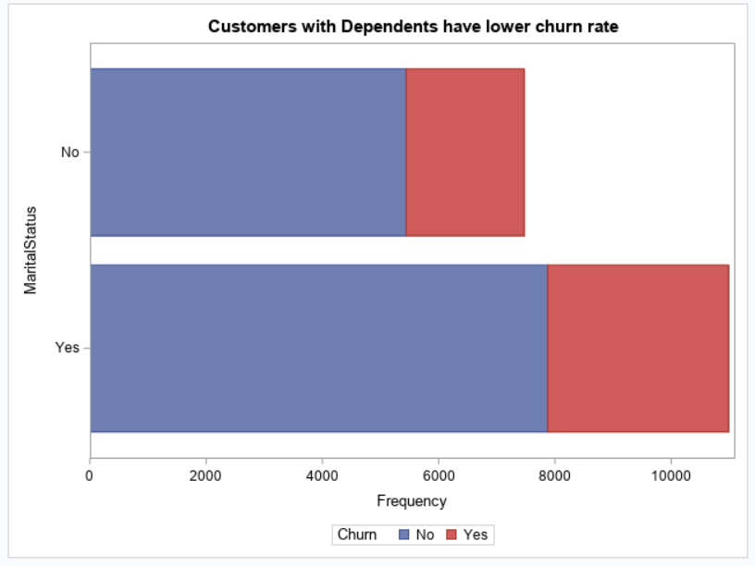
4) Does the numbers of dependents affects the churn ratio? Conclusion: As per this graph, we can see the more the number of dependents the less is the churn rate. May be the customer will prefer to buy a good deal of bundle package as per the number of dependents in the family.
Customers with children have low churn rate
Married customers have low churn rate

Slide 12
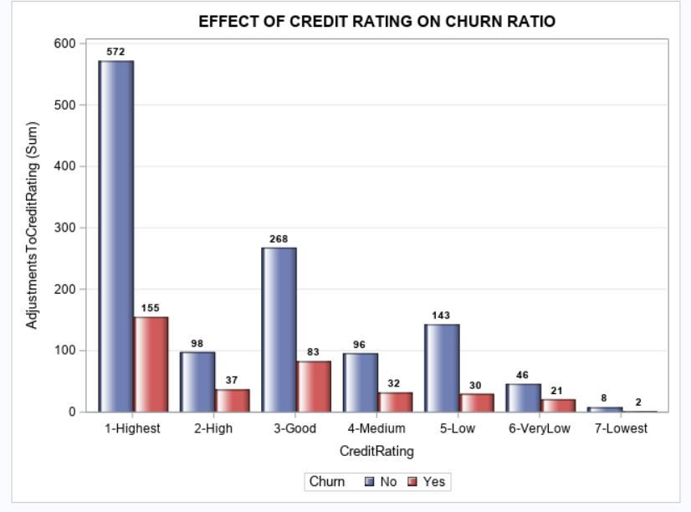
5) Is there any effect of Credit Rating on Churn Rate? Conclusion : According to this graph, the higher the credit rating the less is the churn rate. This may be because customers are well satisfied and paying the bills on time which is showing its effect on the credit rating.

Slide 13
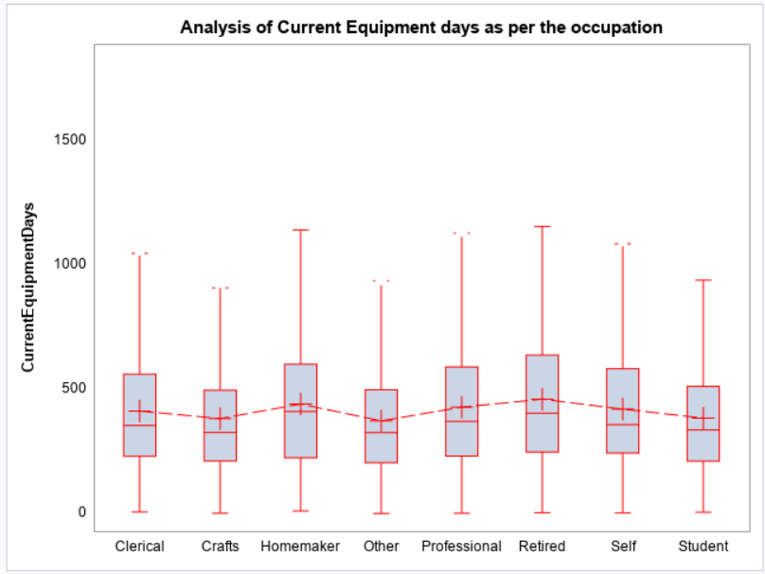
6) Does the number of current equipment days is affected by the occupation? Conclusion: In this box plot, we can analyse that on an average the retired, homemaker and professionals are be with the current plan for more number of days as compared to the others.

Slide 14
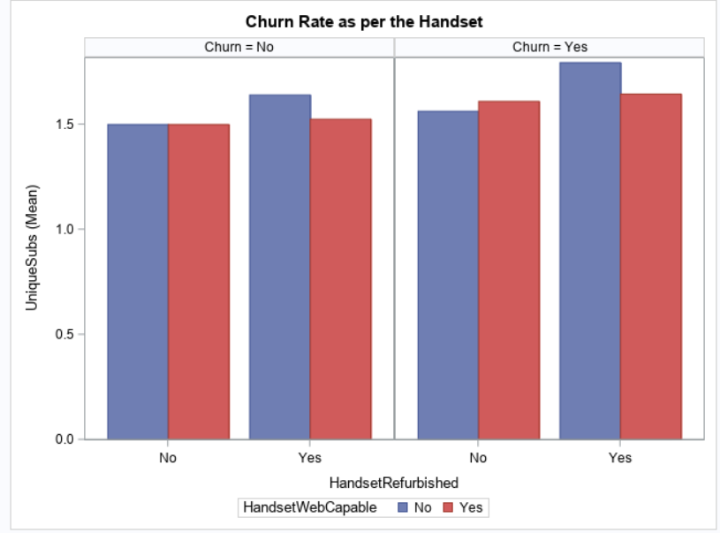
7) What is the effect of handset on the churn rate? Conclusion: With this graph, we can analyse that if the customer refurbished handset is not web capable, then they are at a high risk of churn.

Slide 15
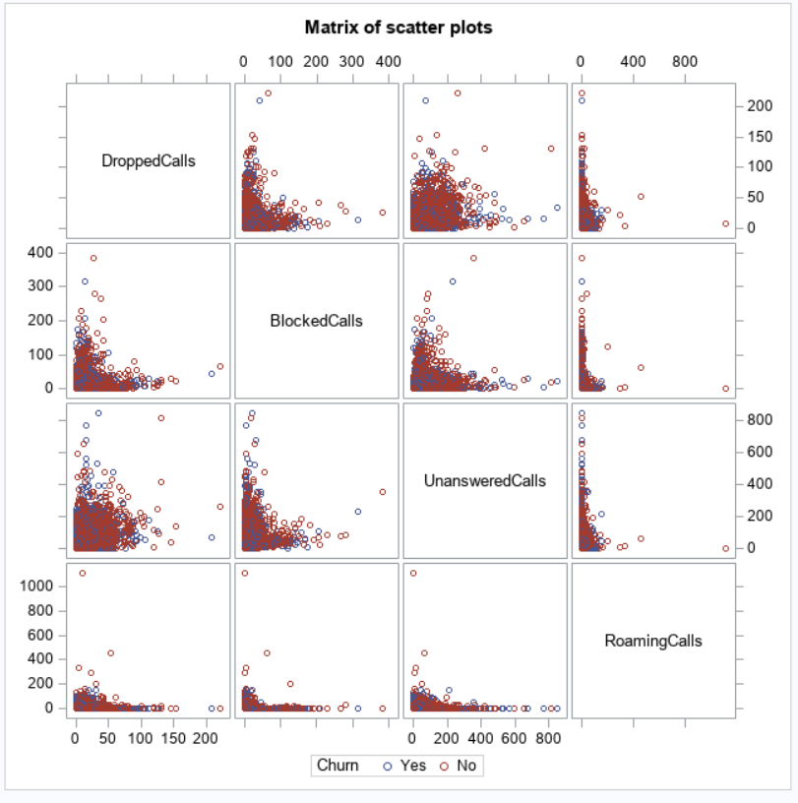
8) Matrix of scatter plot for different variables as per Churn

Slide 16
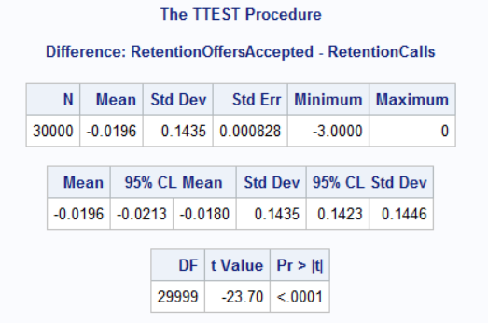
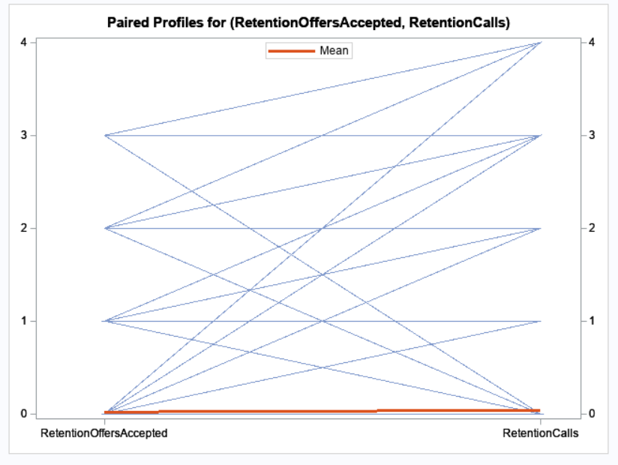
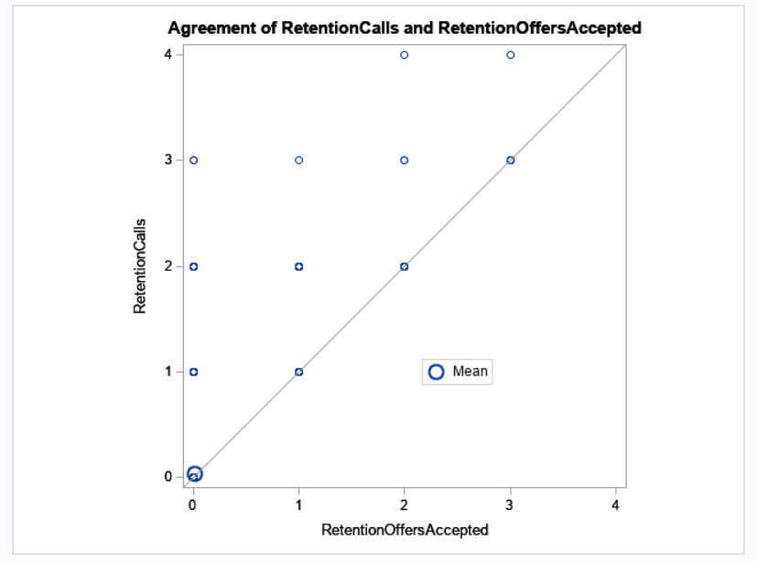
HYPOTHESIS TESTING
The hypothesis testing is a statistical test used to determine whether the hypothesis assumed for the sample of data stands true for the entire population or not.
Setting the Null Hypothesis (Ho) and the Alternative Hypothesis (Ha) at 5% Significance level
Null Hypothesis (Ho) : Making Retention calls does not make any difference.
Alternative Hypothesis (Ha) : Making Retention Calls let the customer to accept the Retention offer.
Since P-value <= 0.05, so we reject the Null Hypothesis(Ho) which means that making Retention calls help in Retaining the customers by offering them good deals.

Slide 17
appendix
LIBNAME RIMA "C:\Users\Veena Nigam\Desktop\SAS Documents\PROJECT";
/*Importing the Dataset*/
PROC IMPORT DATAFILE = "C:\Users\Veena Nigam\Desktop\SAS Documents\PROJECT\Telco Churn Data.csv"
OUT = RIMA.TELECO
DBMS = CSV;
DATAROW = 2;
GUESSINGROWS = 80000;
GETNAMES = YES;
RUN;
/*Describing the properties of the project data*/
PROC CONTENTS DATA = RIMA.TELECO;
RUN;
/*Select Y(Churn) and X variables (Use Proc SQL)*/
PROC SQL;
CREATE TABLE RIMA.PROJECT_VAR AS
SELECT CustomerID, Churn,I NPUT(MonthlyRevenue,BEST12.) AS MonthlyRevenue,INPUT(MonthlyMinutes,BEST12.) AS MonthlyMinutes,totalRecurringCharge,Occupation,CreditRating,AdjustmentsToCreditRating,IncomeGroup,BlockedCalls, UnansweredCalls, MaritalStatus, OverageMinutes,ReceivedCalls,Droppedcalls,MonthsInService,CurrentEquipmentDays, INPUT(AgeHH1,$2.) AS AgeHH1,INPUT(AgeHH2,$2.) AS AgeHH2, ChildrenInHH,Handsets,HandsetModels,RetentionCalls,NewCellphoneUser, MadeCallToRetentionTeam, RetentionOffersAccepted
FROM RIMA.TELECO
WHERE CHURN NE "NA";
QUIT;
/*Checking the normality in distribution*/
%MACRO NORMAL(DATA = ,VARNAME=);
PROC SGPLOT DATA = &DATA.;
TITLE"DISTRIBUTION OF %UPCASE(&VARNAME.)";
HISTOGRAM &VARNAME.;
DENSITY &VARNAME.;
RUN;
%MEND NORMAL;
/*Missing Values Detection*/
/* create a format to group missing and nonmissing */
proc format;
value $missfmt ' '='Missing' other='Not Missing';
value missfmt . ='Missing' other='Not Missing';
run;
proc freq data= Rima.TELECO;
format _CHAR_ $missfmt.;
tables _CHAR_ / missing missprint nocum nopercent;
format _NUMERIC_ missfmt.;
tables _NUMERIC_ / missing missprint nocum nopercent;
run;
/*Missing Values Treatment (Either means or median)*/
PROC STDIZE DATA = RIMA.Teleco OUT= RIMA.TEL1 METHOD= MEAN REPONLY;
VAR PercChangeRevenues MonthlyMinutes MonthlyRevenue TotalRecurringCharge DirectorAssistedCalls OverageMinutes
RoamingCalls PercChangeMinutes PercChangeRevenues;
RUN;

Slide 18
/*TREATING THE OUTLIERS*/
%MACRO OUTLIER (DATA= , VARNAME = );
PROC MEANS DATA = &DATA. MAXDEC = 2 N P25 P75 QRANGE;
VAR &VARNAME.;
OUTPUT OUT = RIMA.DEL P25 = Q1 P75 = Q3 QRANGE=IQR;
RUN;
DATA RIMA.TEMP1;
SET RIMA.DEL ;
LOWER_LIMIT = Q1 - (3*IQR);
UPPER_LIMIT = Q1 + (3*IQR);
RUN;
PROC PRINT DATA = TEMP1;
RUN;
/*CARTESIAN PRODUCT*/
PROC SQL;
CREATE TABLE RIMA.DATA_01 AS
SELECT A.*,B.LOWER_LIMIT, B.UPPER_LIMIT
FROM &DATA. AS A, RIMA.TEMP1 AS B
;
QUIT;
DATA RIMA.DATA_02;
SET RIMA.DATA_01;
IF &VARNAME. LE LOWER_LIMIT THEN &VARNAME._RANGE = "BELOW LOWER LIMIT";
ELSE IF &VARNAME. GE UPPER_LIMIT THEN &VARNAME._RANGE = "ABOVE UPPER LIMIT";
ELSE &VARNAME._RANGE = "WITHIN RANGE";
RUN;
QUIT;
/*PRINTING WITHIN RANGE DATA*/
PROC SQL;
CREATE TABLE RIMA.DATA_03 AS
SELECT *
FROM RIMA.DATA_02
WHERE &VARNAME._RANGE = "WITHIN RANGE";
QUIT;
PROC PRINT DATA=RIMA.DATA_03;
RUN;
%MEND OUTLIER;
%OUTLIER(DATA= , VARNAME= );
/*DATA TRANSFORMATION: CONTINUOUS TO CATEGORICAL VARIABLES*/
PROC MEANS DATA = RIMA.DATA_04 MAXDEC=1 N NMISS MIN MAX RANGE;
VAR MONTHLYMINUTES;
RUN;
PROC FORMAT ;
VALUE REV LOW- 300 = "LOW"
301- 800 = "MEDIUM"
800- HIGH = "HIGH";
RUN;
%LET DSN = RIMA.DATA_04;
%LET VAR1 = MONTHLYMINUTES;
%LET VAR2 = CHURN;
ODS PDF FILE = "C:\Users\Veena Nigam\Desktop\SAS Documents\PROJECT\IMAGES.PDF";
PROC FREQ DATA = &DSN;
TITLE "RELATIONSHIP BETWEEN &VAR1. AND &VAR2.";
TABLE &VAR1. * &VAR2. /CHISQ NOROW NOCOL ;
FORMAT &VAR1. REV.;
RUN;
PROC SGPLOT DATA = &DSN;
TITLE "RELATIONSHIP BETWEEN &VAR1. AND &VAR2.";
VBAR &VAR1./ GROUP = &VAR2. ;
FORMAT &VAR1. REV.;
RUN;
QUIT;
ODS PDF CLOSE;

Slide 19
/*UNIVARIATE ANALYSIS*/
ODS PDF FILE = "C:\Users\Veena Nigam\Desktop\SAS Documents\PROJECT\IMAGES.PDF";
1) PROC UNIVARIATE DATA = RIMA.Mr_03;
TITLE "COMPREHENSIVE UNIVARIATE ANALYSIS OF MONTHLY REVENUE ";
VAR MonthlyRevenue;
RUN;
2) PROC GCHART DATA = RIMA.TELECO_FINAL;
TITLE "DISTRIBUTION OF NEW CELL PHONE USERS";
PIE NEWCELLPHONEUSER/ DISCRETE VALUE=OUTSIDE PERCENT = INSIDE;
RUN;
QUIT;
3) PROC SGPLOT DATA = RIMA.TELECO;
TITLE 'DISTRIBUTION OF TOTAL RECURRING CHARGE';
HISTOGRAM TOTALRECURRINGCHARGE/FILLATTRS=(COLOR=RED) SCALE=PROPORTION;
DENSITY TOTALRECURRINGCHARGE;
RUN;
4) PROC SGPLOT DATA = RIMA.TELECO;
TITLE 'DISTRIBUTION OF MONTHLY REVENUE';
HISTOGRAM MONTHLYREVENUE/FILLATTRS=(COLOR=RED)SCALE=PROPORTION;
DENSITY MONTHLYREVENUE;
RUN;
ODS PDF CLOSE;
/*BIVARIATE ANALYSIS*/
ODS PDF FILE = "C:\Users\Veena Nigam\Desktop\SAS Documents\PROJECT\IMAGES.PDF";
5) PROC SGPLOT DATA = RIMA.TELECO_FINAL;
TITLE'Customers with Dependents have lower churn rate';
HBAR ChildrenInHH/GROUP = CHURN;
RUN;
QUIT;
6) PROC SGPLOT DATA = RIMA.TELECO;
TITLE'Customers with Dependents have lower churn rate';
HBAR MARITALSTATUS/GROUP = CHURN;
RUN;
QUIT;
7) proc sgplot data=RIMA.TELECO_FINAL;
TITLE 'EFFECT OF CREDIT RATING ON CHURN RATIO';
vbar CreditRating/ response= AdjustmentsToCreditRating group=CHURN groupdisplay=cluster
datalabel datalabelattrs = (weight = bold) dataskin=gloss; yaxis grid;
run;
8) proc sgplot data=RIMA.TELECO_FINAL noautolegend;
vbox CURRENTEQUIPMENTDAYS / category= occupation connect=mean connectattrs=(color=RED pattern=mediumdash thickness=1)
meanattrs=(symbol=plus color=red size=20)lineattrs=(color=RED)medianattrs=(color=RED) whiskerattrs=(color=RED)
outlierattrs=(color=green symbol=starfilled size=12); xaxis display=(noline noticks nolabel);
yaxis display=(noline noticks) labelattrs=(weight=bold);
run;
title;
9) PROC SQL;
CREATE TABLE RIMA.SCATTER AS
SELECT DroppedCalls,BlockedCalls,
UnansweredCalls, RoamingCalls, Churn
FROM RIMA.TELECO_FINAL;
QUIT;
proc sgscatter data= rima.scatter;
matrix droppedcalls BlockedCalls UnansweredCalls RoamingCalls/group=churn;
title "Matrix of scatter plots";
run;
title;
10) ods region row=3 column=2;
proc sgpanel data=rima.teleco_final;
panelby churn;
vbar handsetrefurbished / response=uniquesubs group= handsetwebcapable groupdisplay=cluster stat=mean;
title "Churn Rate as per the Handset";
run;
title;
ODS PDF CLOSE;
/*Hypothesis Testing*/
/*HO : THERE IS NO DIFFERENCE
HA : THERE IS A DIFFERENCE*/
/*IF P<=0.05, THEN REJECT H0
*/
/*TTEST*/
PROC TTEST DATA= RIMA.TELECO_FINAL;
PAIRED RetentionOffersAccepted*RetentionCalls;
RUN;

Slide 20
THANK YOU !!!

